Slide 1


BZAN 545
The ADAM Project
Automatic Data Acquisition and Management
Notes:
Brennan - Introductions

Slide 2
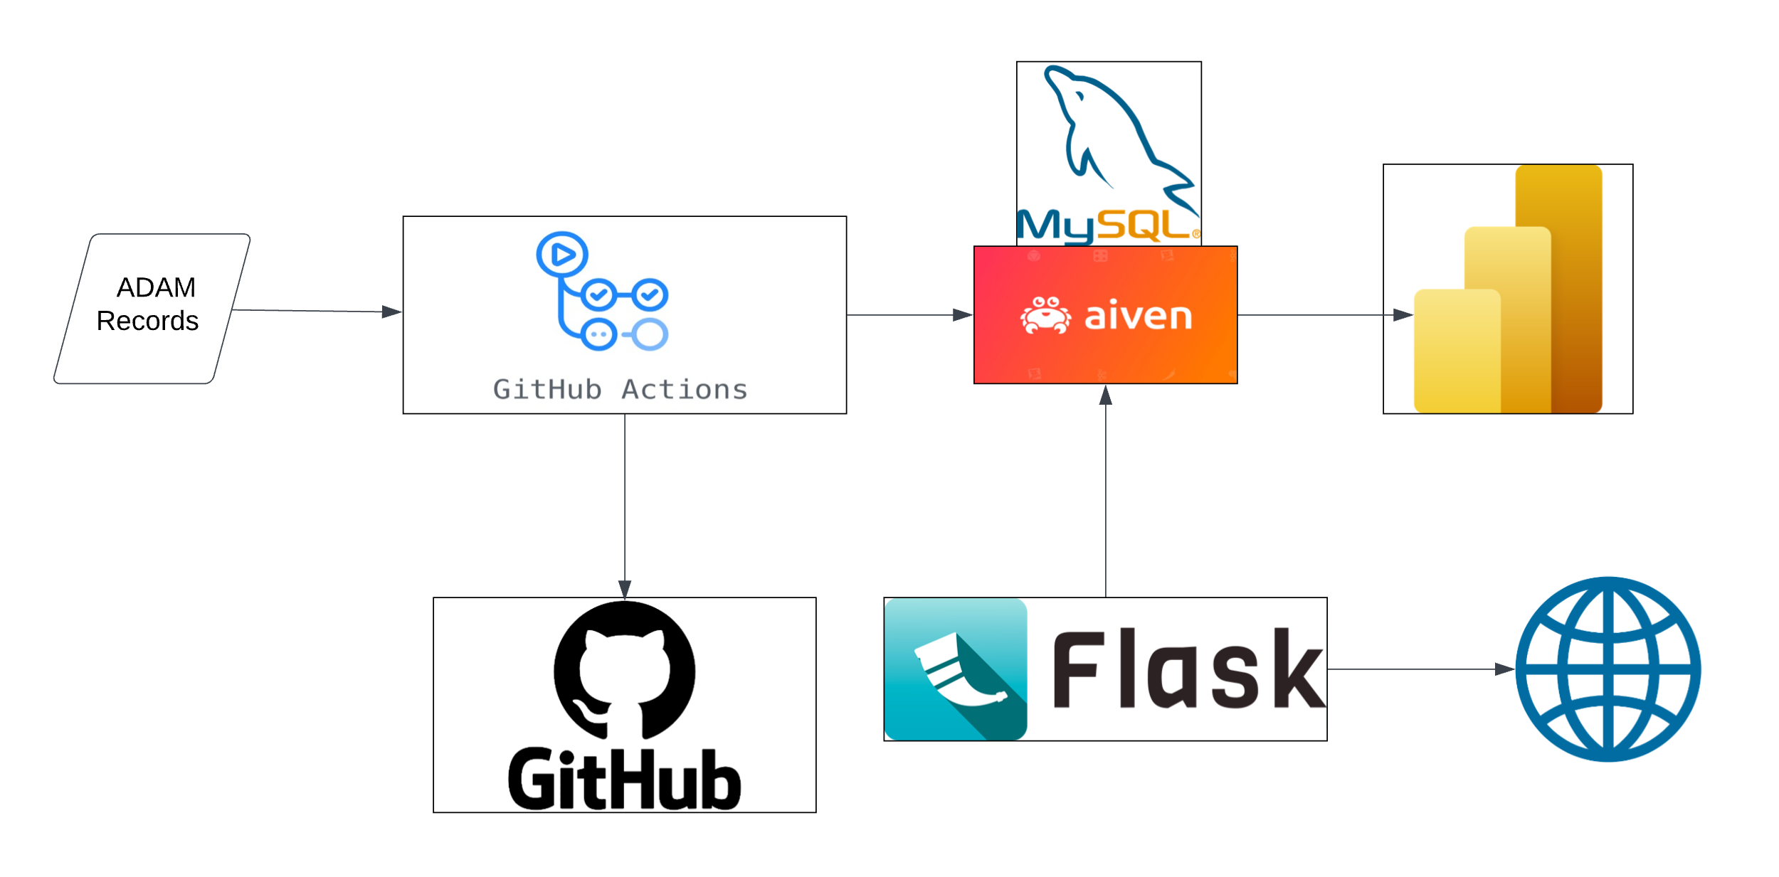


ADAM Infrastructure
Notes:
Slide: General Infrastructure of ADAM
The ADAM workflow automates the execution of a Python script (main.py) using GitHub Actions, scheduled for midnight EST. This script analyzes raw data from a designated URL, updating the database and backing up to GitHub as needed. It evaluates the new data for emptiness, newness, or redundancy and accordingly modifies the Feature_Store table in the database, incorporating error handling for data retrieval and database operations. Additionally, a separate script establishes a database connection, defines table schemas, and performs basic SQL operations. The data is stored in a MySQL database hosted by Aiven, and a Flask API provides access to a random subset of these records. Integration with PowerBI and ODBC allows for comprehensive dashboard visualizations without subset limitations.
Aria

Slide 3

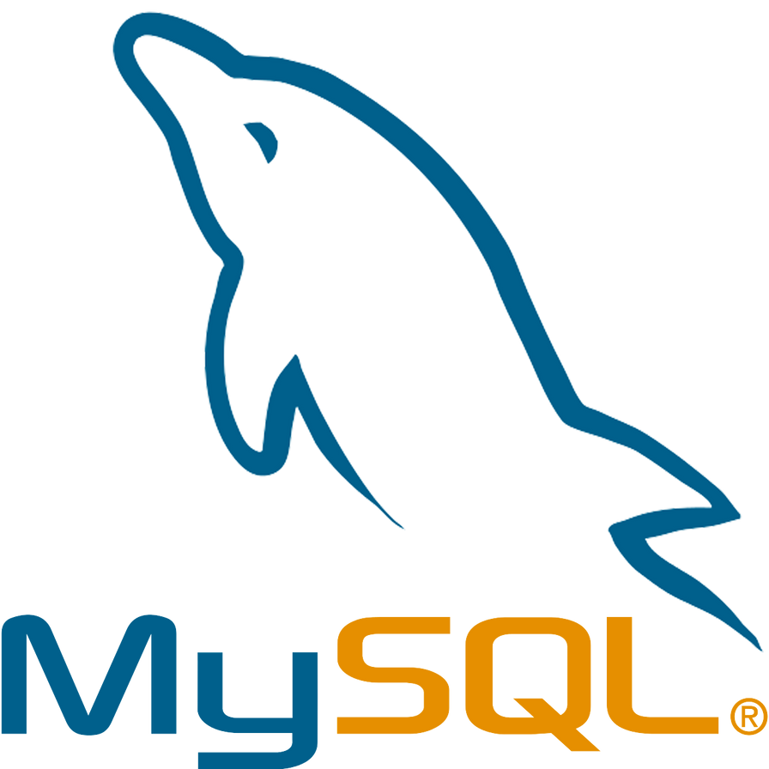

Chosen
Alternatives
Notes:
Slide: Justifications for Choosing MySQL Over PostgreSQL and Microsoft SQL Server
1. **Performance Advantage:**
- MySQL excels in optimized query execution and indexing.
- Efficient storage engine, particularly for read-heavy workloads.
2. **Scalability Features:**
- MySQL demonstrates strong capabilities in handling large datasets and concurrent connections.
- Horizontal scaling is simplified with MySQL Cluster.
3. **Cost Considerations:**
- MySQL's open-source nature translates to potential cost savings.
- Compare licensing costs and highlight any hidden expenses associated with each option.
4. **Community and Support:**
- MySQL boasts an active community with extensive forums, documentation, and third-party resources.
- Compare community support for MySQL with that of PostgreSQL and Microsoft SQL Server.
5. **Feature Set and Compatibility:**
- Discuss MySQL's comprehensive feature set, including support for ACID properties, stored procedures, and triggers.
- Highlight compatibility with various programming languages and compare features with PostgreSQL and Microsoft SQL Server.

Slide 4
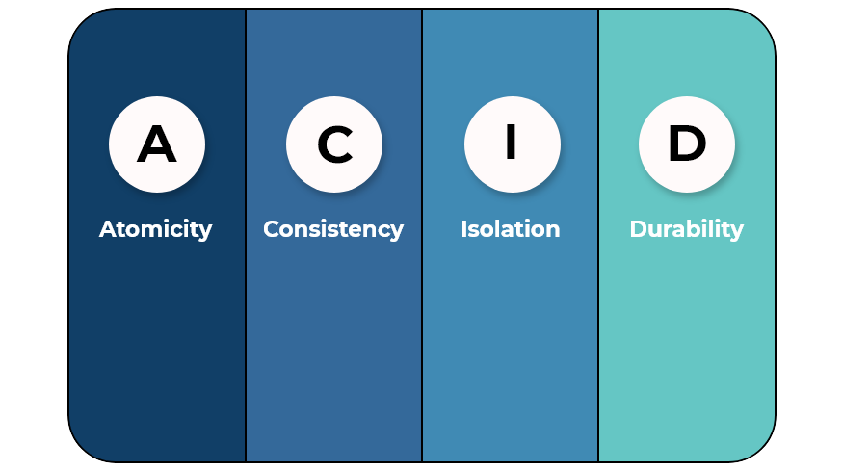
MySQL Justification
Advantages | Disadvantages
1. Open Source | 1. Limited Functionality
2. Scalability | 2. ACID Compliance
3. Community Support | 3. Ownership and Licensing
Notes:
Slide: MySQL Justification
MySQL offers several advantages and drawbacks compared to other SQL flavors. On the plus side, being open-source, it allowed the flexibility we needed for the ADAM project.. Its scalability made it suitable for both small-scale projects and larger, growing systems. Additionally, MySQL benefits from robust community support, providing a wealth of resources and assistance for users, especially for less experienced members of our team. However, it does face limitations in functionality compared to some other SQL databases, which can restrict its use in more complex scenarios. Concerns regarding ACID (Atomicity, Consistency, Isolation, Durability) compliance raise questions about its reliability in certain transactional applications. Finally, the issues surrounding ownership and licensing, especially after its acquisition by Oracle, have led to some uncertainty and potential legal complexities for users. Overall, we felt the pros outweighed the cons in choosing this flavor.
Aria

Slide 5

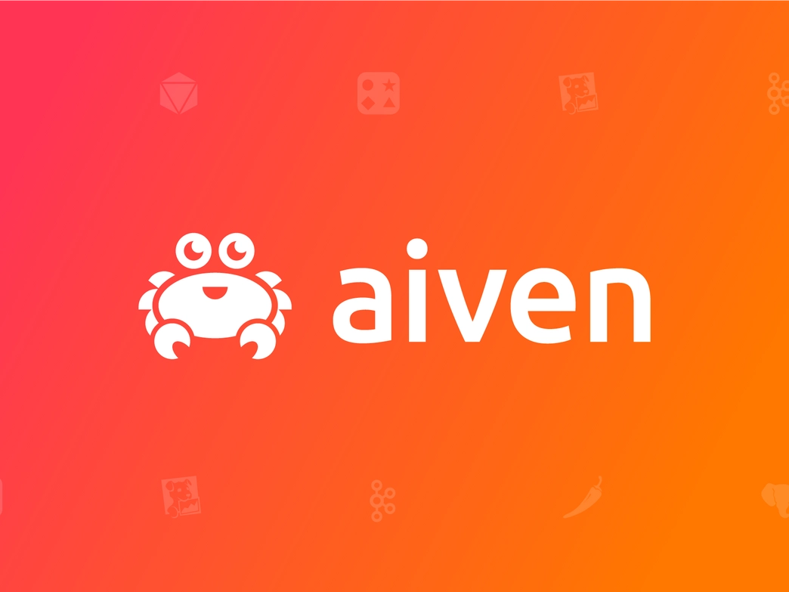

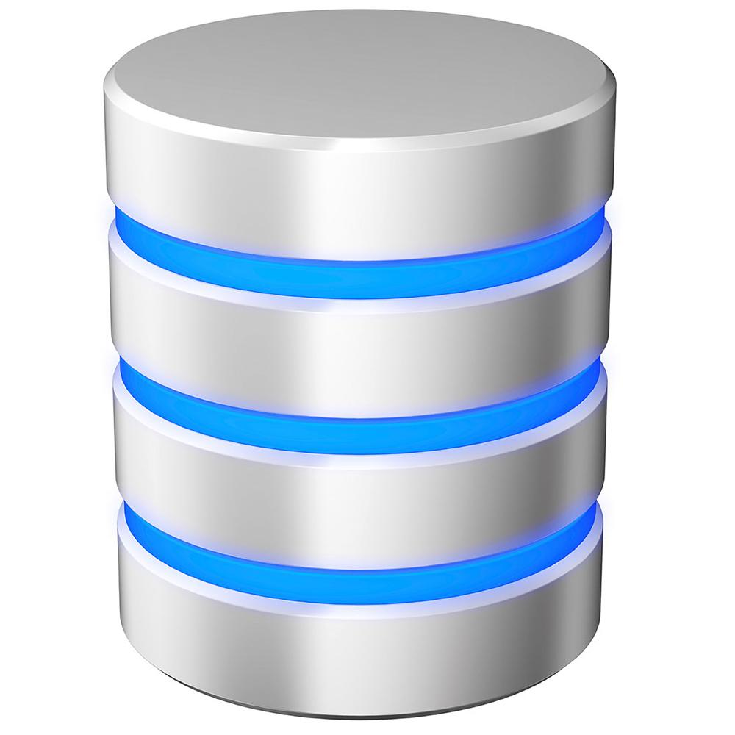
Chosen
Alternatives
Notes:
Slide: Justifications for Choosing Aiven Over CockroachDB and UTK OIT Supported Databases
1. **Cloud-Native Advantage:**
- Aiven is designed as a cloud-native platform, aligning seamlessly with modern cloud environments.
- Discuss how Aiven's architecture enhances scalability and flexibility in cloud deployments.
2. **Managed Service Simplicity:**
- Aiven offers a fully managed service, reducing operational overhead for the user.
- Highlight the ease of deployment, maintenance, and automatic updates provided by Aiven.
3. **Multi-Cloud Support:**
- Aiven supports multiple cloud providers, providing flexibility in choosing the preferred cloud infrastructure.
- Discuss the advantages of multi-cloud support compared to CockroachDB and UTK OIT supported databases.
4. **Performance and Scalability:**
- Highlight Aiven's performance optimization for various workloads.
- Discuss how Aiven handles scalability challenges efficiently, adapting to growing data and user demands.
5. **Security and Compliance:**
- Discuss Aiven's security features, such as encryption, authentication, and compliance certifications.
- Compare the security measures of Aiven with those of CockroachDB and UTK OIT supported databases.

Slide 6
aiven Justification
Advantages | Disadvantages
1. Free (for the base offering) | 1. Cost - Can be more expensive than self-hosting
2. Managed Services | 2. Limited Control over Infrastructure
3. Multi-Cloud Support | 3. Reliance on Aiven's Service Reliability
Notes:
Slide: Aiven Justification
The use of Aiven for database management comes with its own set of advantages and disadvantages. Aiven's base subscription is free, which made it an attractive option for us. Its managed services aspect significantly reduces the overhead of database administration, allowing users to focus more on their core activities. Additionally, Aiven's support for multi-cloud environments provides flexibility for our provider choices. However, the cost aspect can become a disadvantage as needs grow beyond the base offering, but we did not feel this would become an issue. Users also face limited control over the infrastructure, which might be a drawback if we sought a highly customized database environments. Lastly, there's an inherent reliance on Aiven's service reliability, meaning that any downtime or performance issues on Aiven's end could directly impact our operations. Ultimately, we felt the pros outweighed the cons in choosing Aiven’s services.
Aria

Slide 7

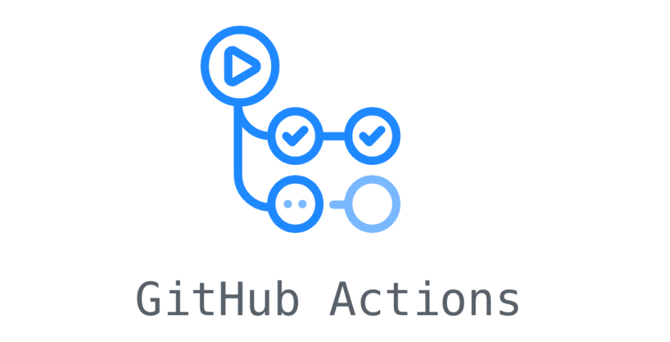

Chosen
Alternatives
Notes:
Slide: Chosen workflow automation
After consulting the various options, we chose GitHub actions to automate our workflow over other alternatives such as Travis CI or Jenkins. We will go over specifics on why momentarily.
Aria

Slide 8
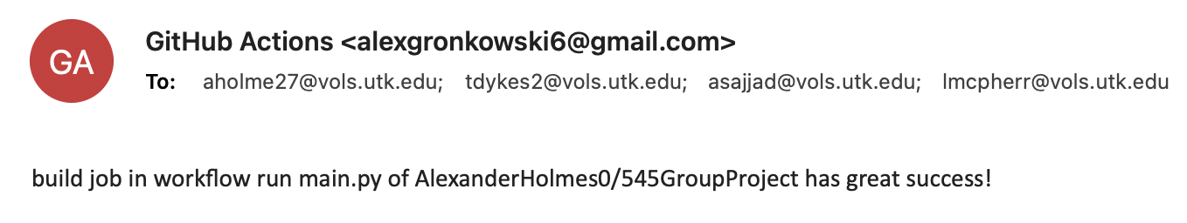

Notes:
Slide: Github Actions email screenshot
This is an example of one of our automated emails that is sent out by trusty GitHub actions, notifying us that our main python script has ran successfully. Great Success!
Aria

Slide 9
GitHub Actions Justification
Advantages | Disadvantages
1. Continuous Integration and Automation | 1. Limited Concurrency for Free Accounts
2. Integration with GitHub repositories | 2. Learning Curve for Complex Workflows
3. Large Ecosystem of Community-Made Actions | 3. Cost for Heavy Usage
Notes:
Slide: Github Actions Justification
We opted for GitHub Actions in our project, favoring its strengths over alternatives like Travis CI or Jenkins. Key to our decision was GitHub Actions' robust capabilities in continuous integration and automation, streamlining our development pipeline efficiently. Its seamless integration with GitHub repositories significantly enhanced our workflow, as it allowed for easier management and coordination of code directly within the GitHub ecosystem. Moreover, the extensive ecosystem of community-made actions available in GitHub Actions offered us a wide range of pre-built solutions, saving time and effort in workflow setup. To accomplish the same tasks with Travis CI or Jenkins would have required a paid subscription, as their free versions would not suffice. However, we had to consider its limitations, such as limited concurrency for free accounts, which could impact parallel task execution. The learning curve for setting up complex workflows, especially cooperating with automated permissions, and the potential cost for heavy usage were also factors, but these were outweighed by the overall benefits GitHub Actions provided for our project needs.
Aria

Slide 10



Chosen
Alternatives
Notes:
We chose Flask API as our api of choice over Django and Fast API.
-Lucas

Slide 11
Flask Justification
Advantages | Disadvantages
1. Simplicity | 1. Limited Built-in Features
2. Flexibility | 2. Not Ideal for Large Projects
3. Community and Ecosystem | 3. Security Concerns
Notes:
So our reasons are mainly just how basic it is. For our business justification we did not need a whole bunch running in the background with our API, just needed a simple database connection to pull our data from. These may be disadvantages in some eyes, but with the level we needed for our project, the limited built in features allowed the creation process to be very simplistic and flexible, as it has continued to be as we have made changes and updates.
One major problem we have is the worry of security concerns. Currently our API is housed in GitHub and if it was to be posted, there is a security risk with our credentials. Our database requires credentials to be seen and connected to, thus the API must have them. Thankfully many platforms support a “secret” file system where these are protected. However still it does pose a security concern as depending on who we were to host it on, there is always a worry of data leakage.
-Lucas

Slide 12
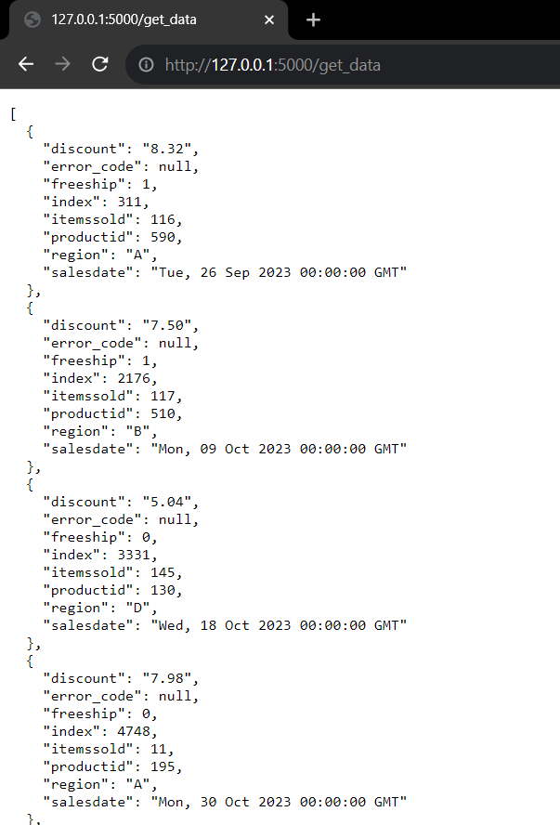
Notes:
Here is a screenshot of our API being hosted on a personal device. As of right now, It produces a simple JSON script with 10 random rows. As you can see in the address bar, simply putting “get_data” will connect to the root and display the data requested. This can also be updated to receive requests of certain data, but we decided it was not a necessity right now.
-Lucas

Slide 13

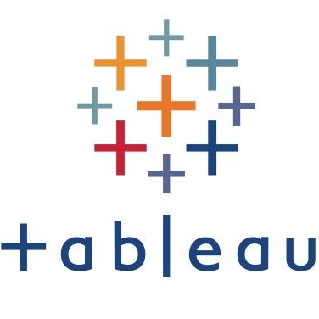


Chosen
Alternatives
Notes:
We chose BI with an ODBC connection over Tablaeu and Shiny app options. We chose to do an ODBC connection over our API as it creates a direct connection rather then having to have a posted API. This also allowed us to get more system data, which we will get more into shortly.
-Tyler

Slide 14
PowerBI Justification
Advantages | Disadvantages
1. Data Visualization | 1. Learning Curve for Complex Data Modeling (DAX)
2. Ease of Use and user “Drill Down” Feature | 2. Limited Non-Microsoft Integration
3. Integration | 3. Cost Scalability as User Base Grows
Notes:
We chose BI for our dashboard creation because it has some higher level analytical techniques we can use to be interpret and show our data. (I.e. Time series, measure and column creations, advanced filtering techniques). Visualizations can also be created through python as well.
PowerBi is also versatile, as the ease of use spans from a avid non experienced viewer, to a more technical individual who wants to know what exactly the data is doing. PowerBI supports a “Drill Down” feature on all of the visualizations where you can view the specific data powering the visualization.
PowerBi also has great integrations through its online platform.
Some of our disadvantages are having to learn DAX for analysis, can be difficult to integrate with some non-Microsoft products, and it can get costly as the user base grows. -Tyler

Slide 15
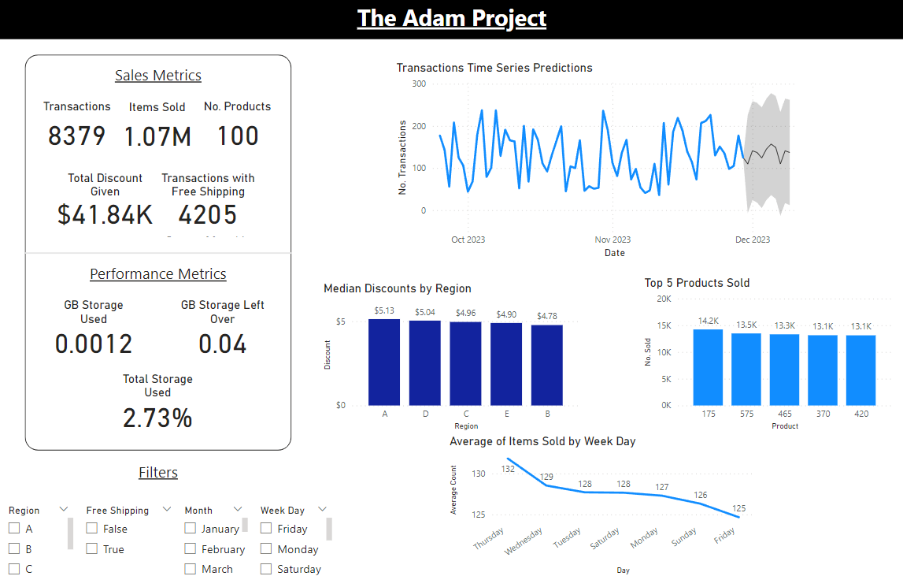
Notes:
This is a quick snippet of our dashboard (updated as of yesterday). Starting in our top left, we have some overview metrics showing the base of what is currently going on within our database. Just to get an high angle idea of what is happening. Right now we have our total transactions at 8,379, total items sold at 1.07 Million, 100 total different products, how much discount we have given, and how many transactions we have sent with free shipping. Below this we have some performance metrics of our database and how much storage we are using. Our database may currently be small, but the data isn’t taking much of the space up. If data entry continues how it is currently, we will be able to continue to store data for the next 3 years. However in the future we need to upgrade to a higher storage capacity as we grow.
On the right hand side we have a time series of our data since the creation of scraping algorithm, with a small prediction interval for the days to come. Following that, these three plots give us some quick visualization of the discount distributions of Region, sales by week days, and the products being sold.
Finally in the bottom left corner we have some dynamic filters that can allow the user to filter across the entire dashboard on things like Region, Free Shipping, Month, and Week day. These are dynamic as multiple filters and selection inside said filters can be click to drill down into what the user is looking for.
-Tyler

Slide 16
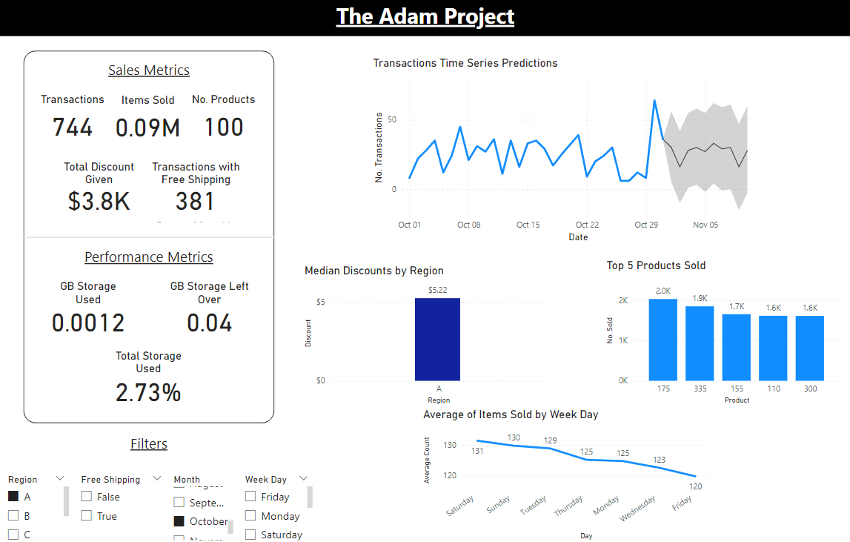
Notes:
As an example, if you are the Regional Manager over Region A, and wanted to see how your region did during the month of October, we can filter on these parameters to see how your region is doing.

Slide 17
Task | Team Member(s)
Database Creation | Alex and Aria
Data Scraping | Alex and Aria
Data Preparation | Alex and Aria
Dashboard Creation | Tyler and Lucas
API Creation | Tyler and Lucas
Show and Tell Slide Deck | Lucas and Aria
This amazing slide deck | Tyler, Aria, and Lucas

Slide 18
Thanks!
Any Questions?

